Slide 1


Azərbaycan Dövlət Neft və Sənaye Universiteti
Linear Algebra

Slide 2
One of the most important topics of linear algebra is eigenvalues.
Eigenvalues are used in a wide variety of real-life applications of linear algebra:
in solving systems of differential equations
in engineering, social and natural sciences
demography
analysis of weather, etc.
Introduction to Eigenvalues

Slide 3
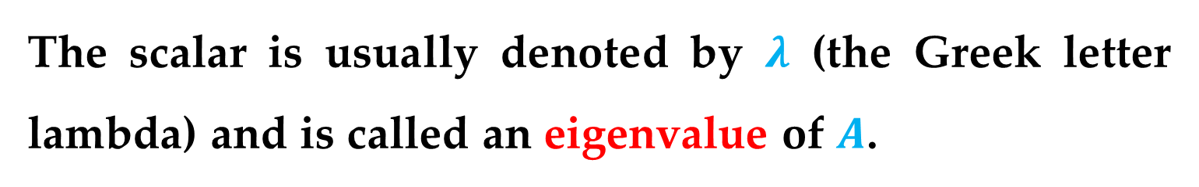
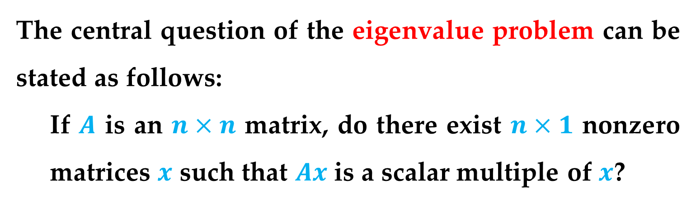
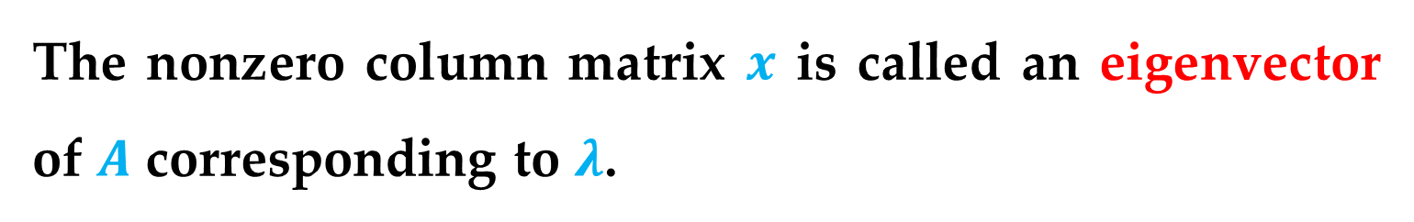
Definition
The central question of the eigenvalue problem can be stated as follows:
If $A$ is an $n×n$ matrix, do there exist $n×1$ nonzero matrices $x$ such that $Ax$ is a scalar multiple of $x$?
The scalar is usually denoted by $λ$ (the Greek letter lambda) and is called an eigenvalue of $A$.
The nonzero column matrix $x$ is called an eigenvector of $A$ corresponding to $λ$.
Introduction to Eigenvalues

Slide 4
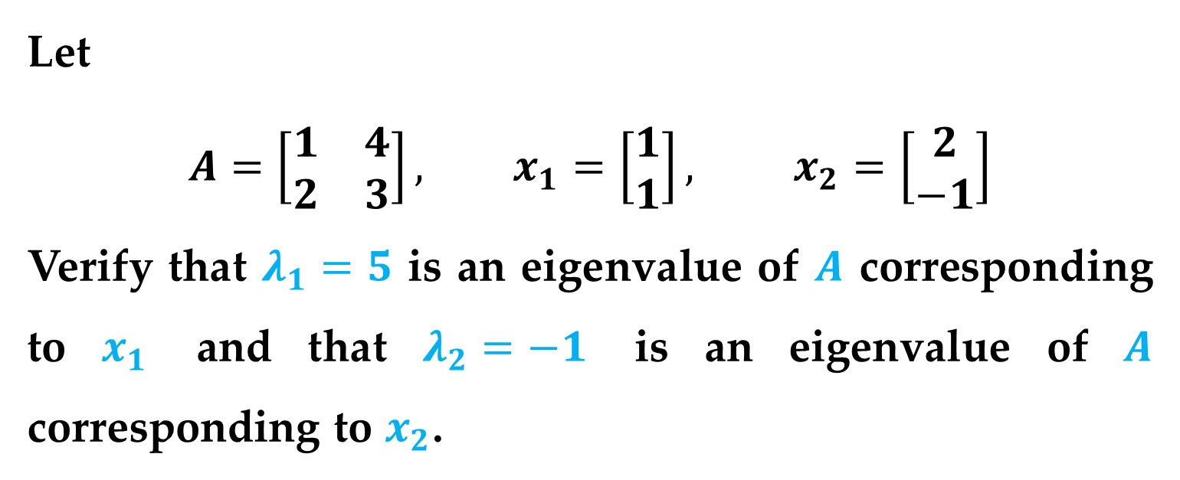

The fundamental equation for the eigenvalue problem is
$$Ax=λx$$
Example 1 (Verifying Eigenvalues and Eigenvectors)
Let
$$A=\left[\begin{matrix}1 & 4 \\ 2 & 3\end{matrix}\right], x_{1}=\left[\begin{matrix}1 \\ 1\end{matrix}\right], x_{2}=\left[\begin{matrix}2 \\ −1\end{matrix}\right]$$
Verify that $λ_{1}=5$ is an eigenvalue of $A$ corresponding to $x_{1}$ and that $λ_{2}=−1$ is an eigenvalue of $A$ corresponding to $x_{2}$.
Introduction to Eigenvalues

Slide 5
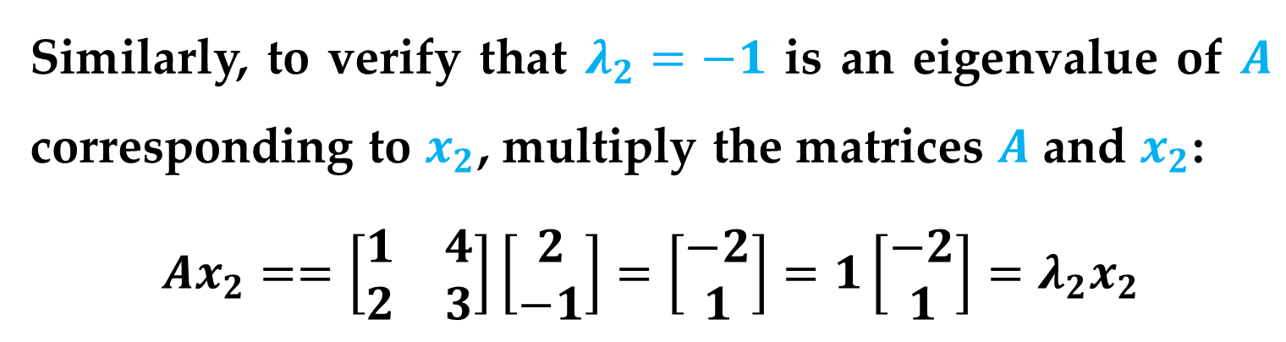
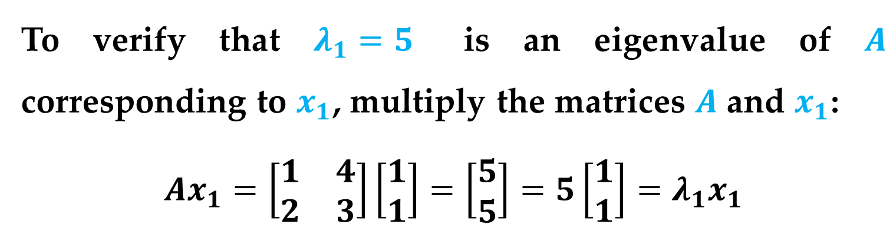
Solution
To verify that $λ_{1}=5$ is an eigenvalue of $A$ corresponding to $x_{1}$, multiply the matrices $A$ and $x_{1}$:
$$Ax_{1}=\left[\begin{matrix}1 & 4 \\ 2 & 3\end{matrix}\right]\left[\begin{matrix}1 \\ 1\end{matrix}\right]=\left[\begin{matrix}5 \\ 5\end{matrix}\right]=5\left[\begin{matrix}1 \\ 1\end{matrix}\right]=λ_{1}x_{1}$$
Similarly, to verify that $λ_{2}=−1$ is an eigenvalue of $A$ corresponding to $x_{2}$, multiply the matrices $A$ and $x_{2}$:
$$Ax_{2}==\left[\begin{matrix}1 & 4 \\ 2 & 3\end{matrix}\right]\left[\begin{matrix}2 \\ −1\end{matrix}\right]=\left[\begin{matrix}−2 \\ 1\end{matrix}\right]=1\left[\begin{matrix}−2 \\ 1\end{matrix}\right]=λ_{2}x_{2}$$
Introduction to Eigenvalues

Slide 6
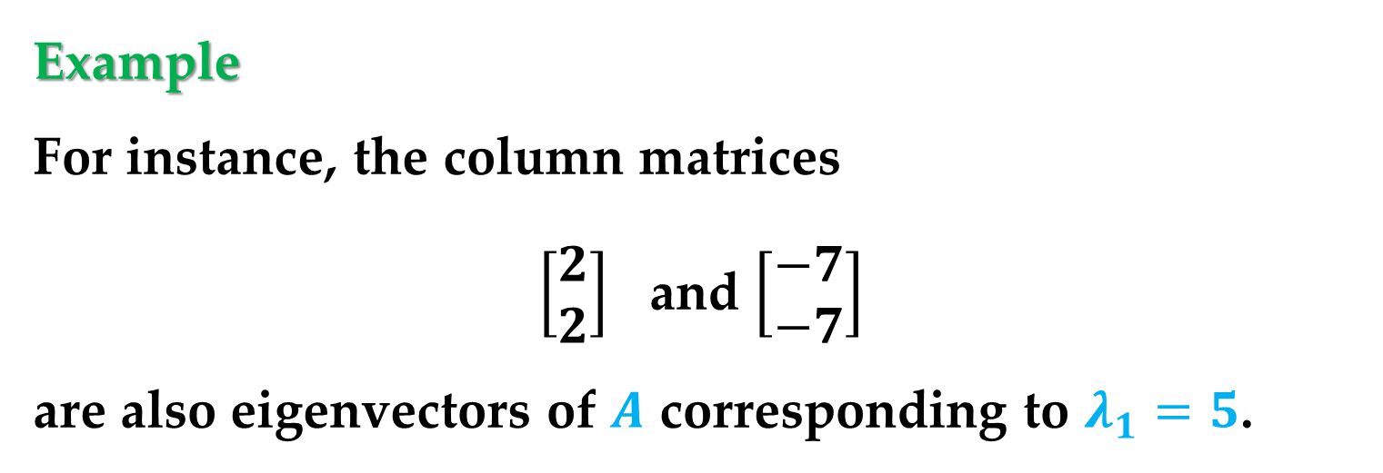
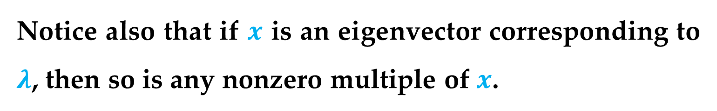
Remark
Notice also that if $x$ is an eigenvector corresponding to $λ$, then so is any nonzero multiple of $x$.
Example
For instance, the column matrices
$\left[\begin{matrix}2 \\ 2\end{matrix}\right]$ and $\left[\begin{matrix}−7 \\ −7\end{matrix}\right]$
are also eigenvectors of $A$ corresponding to $λ_{1}=5$.
Introduction to Eigenvalues

Slide 7
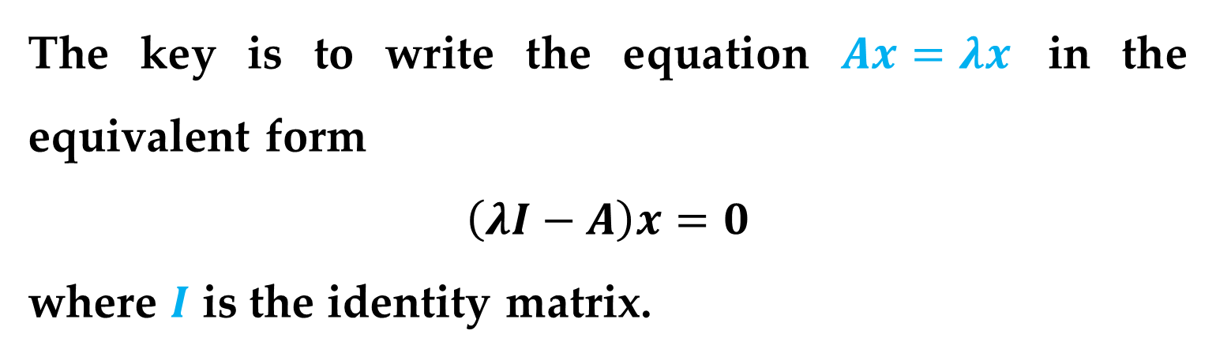

Question
Provided with an $n×n$ matrix $A$, how can you find the eigenvalues and corresponding eigenvectors?
The key is to write the equation $Ax=λx$ in the equivalent form
$$\left(λI−A\right)x=0$$
where $I$ is the identity matrix.

Slide 8
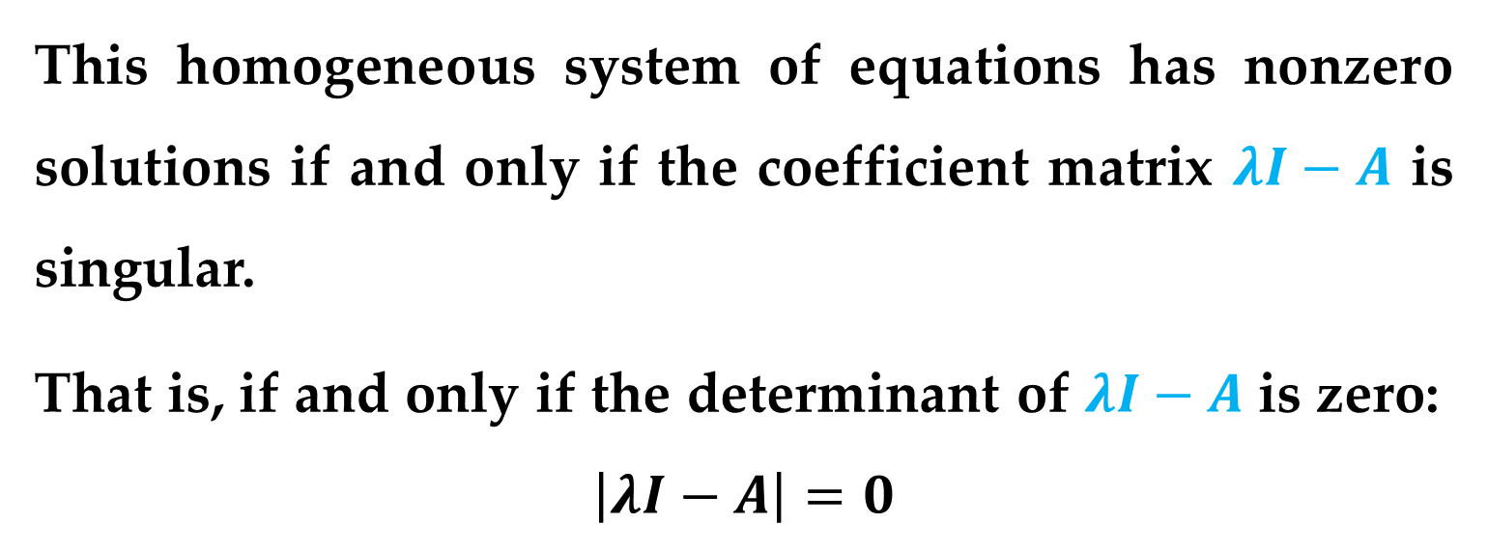
This homogeneous system of equations has nonzero solutions if and only if the coefficient matrix $λI−A$ is singular.
That is, if and only if the determinant of $λI−A$ is zero:
$$\left|λI−A\right|=0$$
Introduction to Eigenvalues

Slide 9
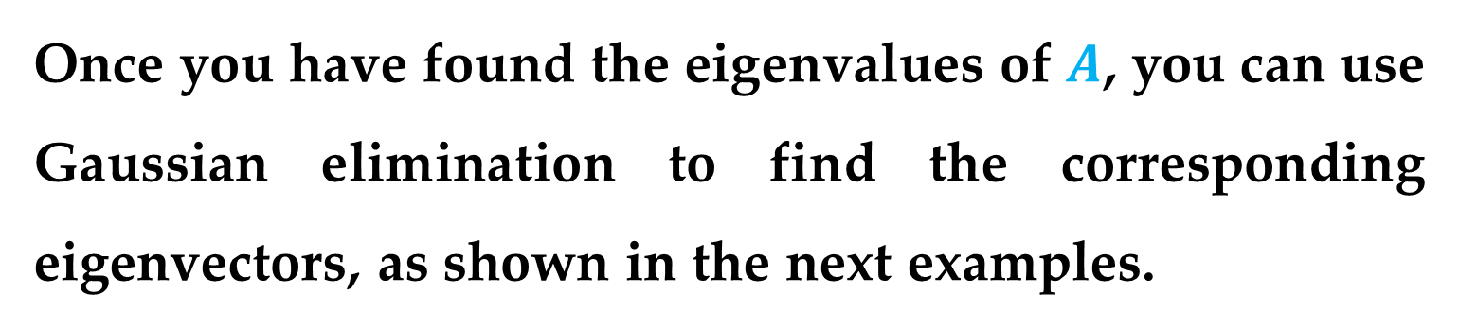
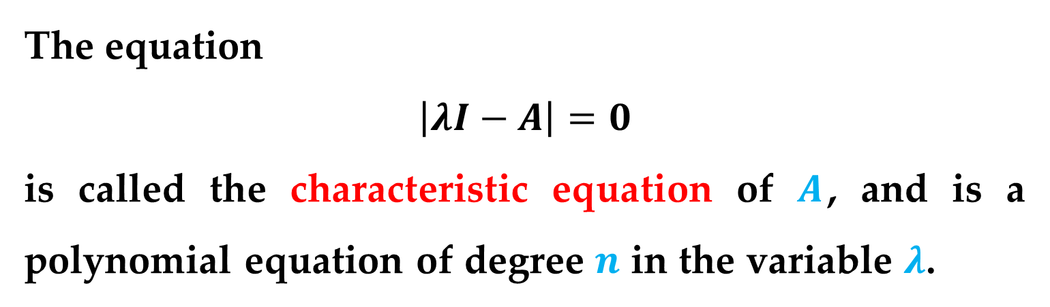
Definition
The equation
$$\left|λI−A\right|=0$$
is called the characteristic equation of $A$, and is a polynomial equation of degree $n$ in the variable $λ$.
Once you have found the eigenvalues of $A$, you can use Gaussian elimination to find the corresponding eigenvectors, as shown in the next examples.
Introduction to Eigenvalues

Slide 10
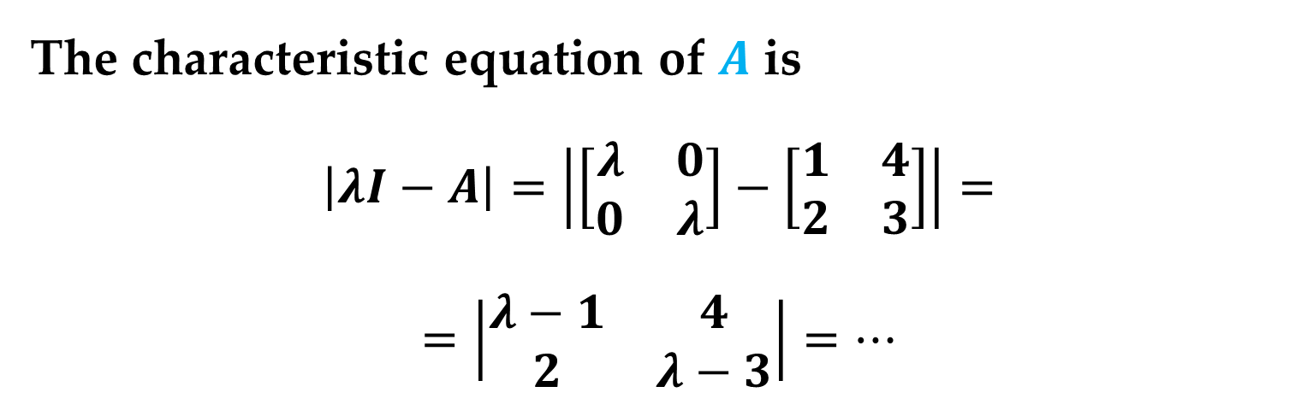
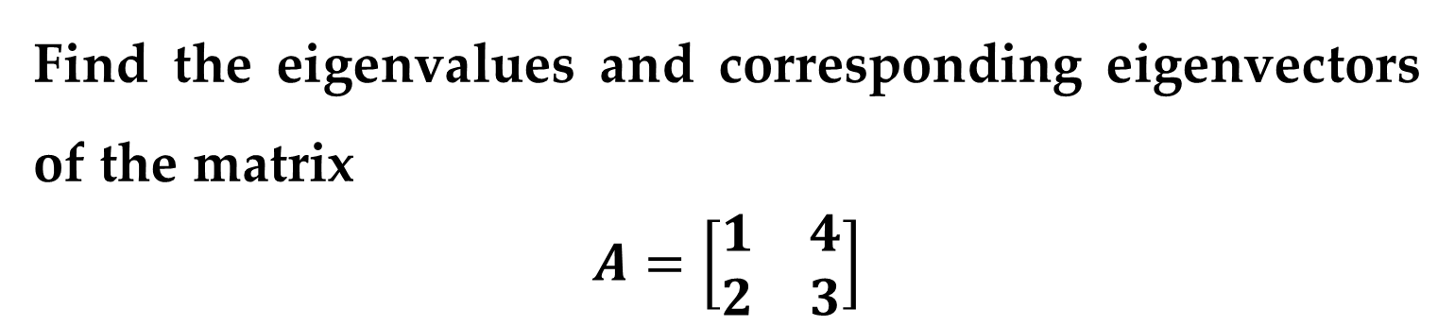
Example 2. Finding Eigenvalues and Eigenvectors
Find the eigenvalues and corresponding eigenvectors of the matrix
$$A=\left[\begin{matrix}1 & 4 \\ 2 & 3\end{matrix}\right]$$
Solution
The characteristic equation of $A$ is
$$\left|λI−A\right|=\left|\left[\begin{matrix}λ & 0 \\ 0 & λ\end{matrix}\right]−\left[\begin{matrix}1 & 4 \\ 2 & 3\end{matrix}\right]\right|=$$
$$=\left|\begin{matrix}λ−1 & 4 \\ 2 & λ−3\end{matrix}\right|=…$$
Introduction to Eigenvalues

Slide 11


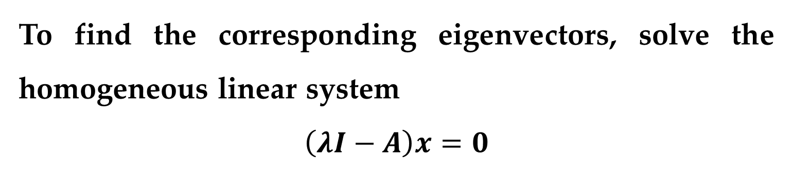
Solution (continued)
$$…=\left(λ−1\right)\left(λ−3\right)−\left(2\right)\left(4\right)=$$
$$=λ^{2}−4λ−5$$
This yields two eigenvalues
$λ_{1}=5$ and $λ_{2}=−1$
To find the corresponding eigenvectors, solve the homogeneous linear system
$$\left(λI−A\right)x=0$$
Introduction to Eigenvalues

Slide 12
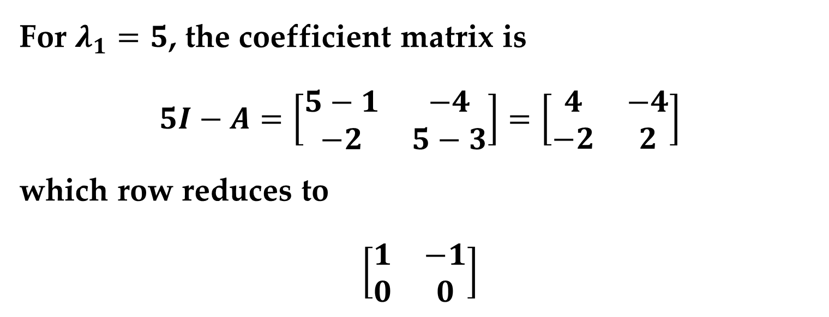
Solution (continued)
For $λ_{1}=5$, the coefficient matrix is
$$5I−A=\left[\begin{matrix}5−1 & −4 \\ −2 & 5−3\end{matrix}\right]=\left[\begin{matrix}4 & −4 \\ −2 & 2\end{matrix}\right]$$
which row reduces to
$$\left[\begin{matrix}1 & −1 \\ 0 & 0\end{matrix}\right]$$
Introduction to Eigenvalues

Slide 13
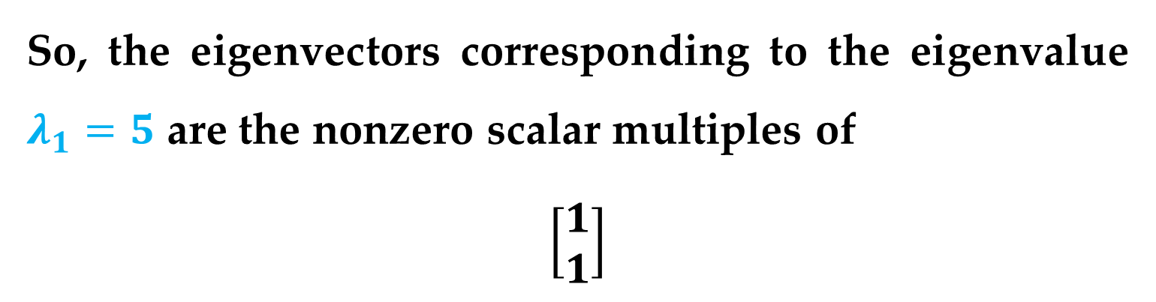
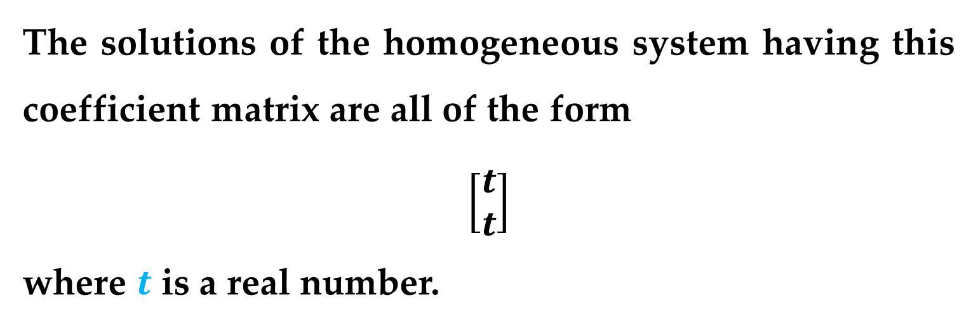
Solution (continued)
The solutions of the homogeneous system having this coefficient matrix are all of the form
$$\left[\begin{matrix}t \\ t\end{matrix}\right]$$
where $t$ is a real number.
So, the eigenvectors corresponding to the eigenvalue $λ_{1}=5$ are the nonzero scalar multiples of
$$\left[\begin{matrix}1 \\ 1\end{matrix}\right]$$
Introduction to Eigenvalues

Slide 14

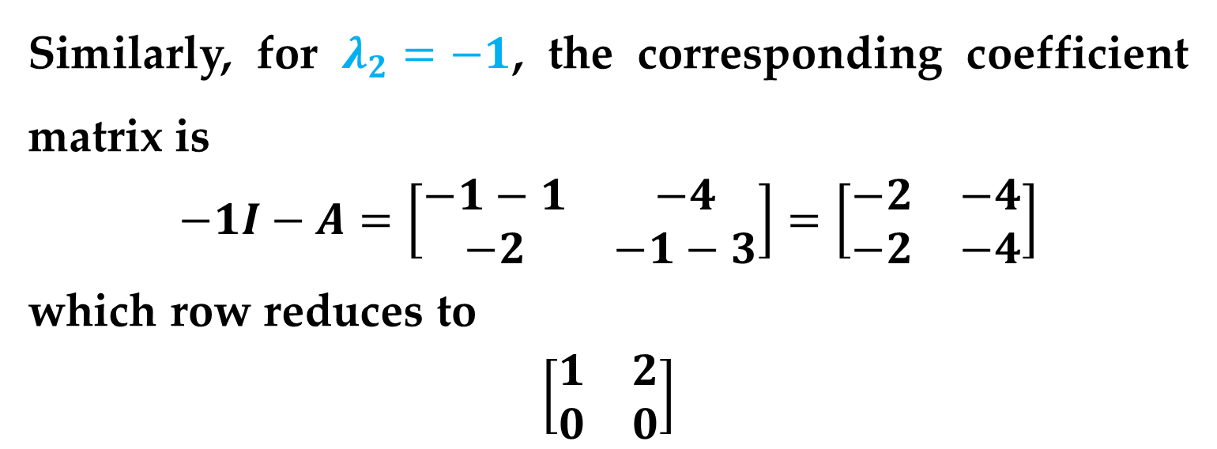
Solution (continued)
Similarly, for $λ_{2}=−1$, the corresponding coefficient matrix is
$$−1I−A=\left[\begin{matrix}−1−1 & −4 \\ −2 & −1−3\end{matrix}\right]=\left[\begin{matrix}−2 & −4 \\ −2 & −4\end{matrix}\right]$$
which row reduces to
$$\left[\begin{matrix}1 & 2 \\ 0 & 0\end{matrix}\right]$$
The solutions of the homogeneous system having this coefficient matrix are all of the form
$$\left[\begin{matrix}2t \\ −t\end{matrix}\right]$$
where $t$ is a real number.

Slide 15
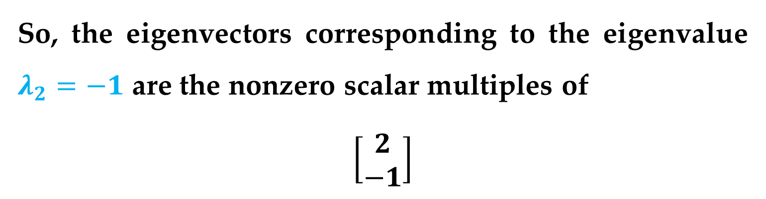
Solution (continued)
So, the eigenvectors corresponding to the eigenvalue $λ_{2}=−1$ are the nonzero scalar multiples of
$$\left[\begin{matrix}2 \\ −1\end{matrix}\right]$$
Introduction to Eigenvalues

Slide 16
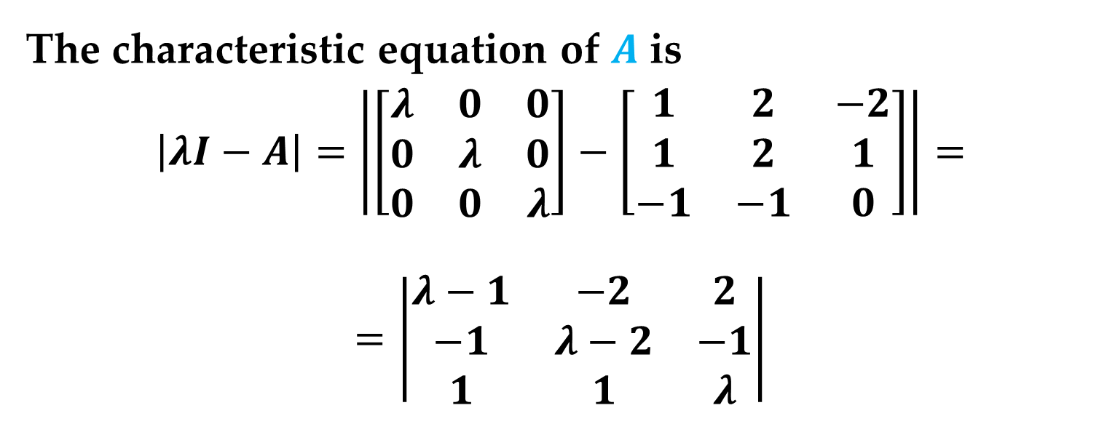
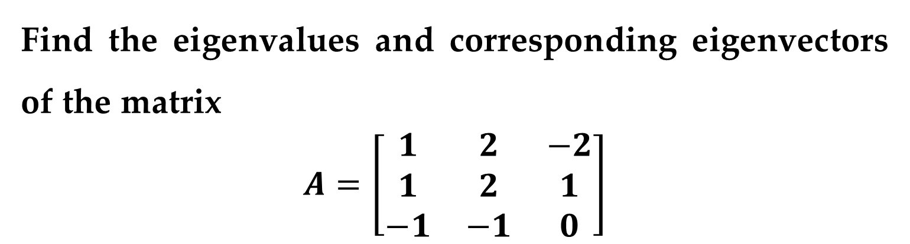
Example 3. Finding Eigenvalues and Eigenvectors
Find the eigenvalues and corresponding eigenvectors of the matrix
$$A=\left[\begin{matrix}1 & 2 & −2 \\ 1 & 2 & 1 \\ −1 & −1 & 0\end{matrix}\right]$$
Solution
The characteristic equation of $A$ is
$$\left|λI−A\right|=\left|\left[\begin{matrix}λ & 0 & 0 \\ 0 & λ & 0 \\ 0 & 0 & λ\end{matrix}\right]−\left[\begin{matrix}1 & 2 & −2 \\ 1 & 2 & 1 \\ −1 & −1 & 0\end{matrix}\right]\right|=$$
$$=\left|\begin{matrix}λ−1 & −2 & 2 \\ −1 & λ−2 & −1 \\ 1 & 1 & λ\end{matrix}\right|$$

Slide 17


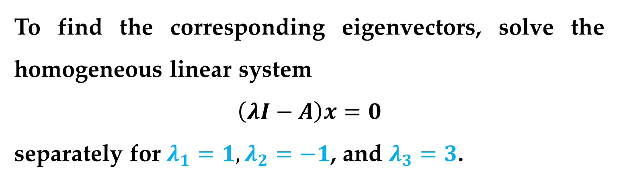
Solution (continued)
The determinant of this matrix is
$$\left|λI−A\right|=λ^{3}−3λ^{2}−λ+3=$$
$$=(λ^{2}−1)(λ−3)$$
This yields three eigenvalues
$$λ_{1}=1, λ_{2}=−1, λ_{3}=3$$
To find the corresponding eigenvectors, solve the homogeneous linear system
$$\left(λI−A\right)x=0$$
separately for $λ_{1}=1,λ_{2}=−1$, and $λ_{3}=3$.

Slide 18
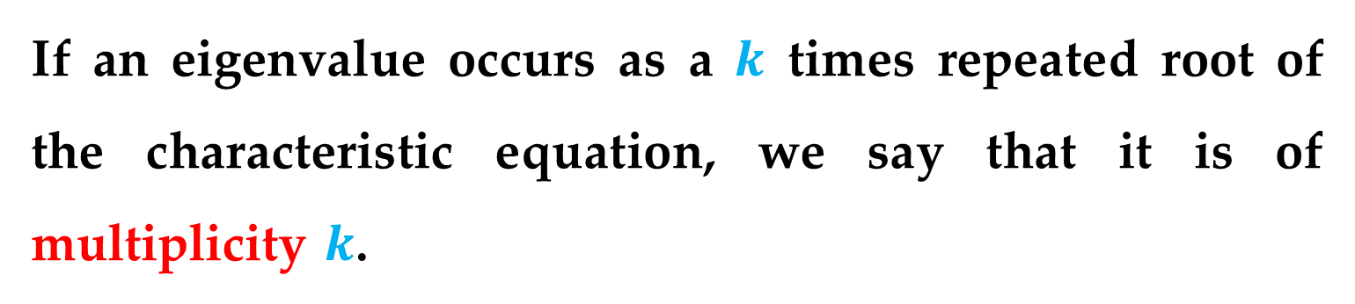
Definition
If an eigenvalue occurs as a $k$ times repeated root of the characteristic equation, we say that it is of multiplicity $k$.
Introduction to Eigenvalues

Slide 19
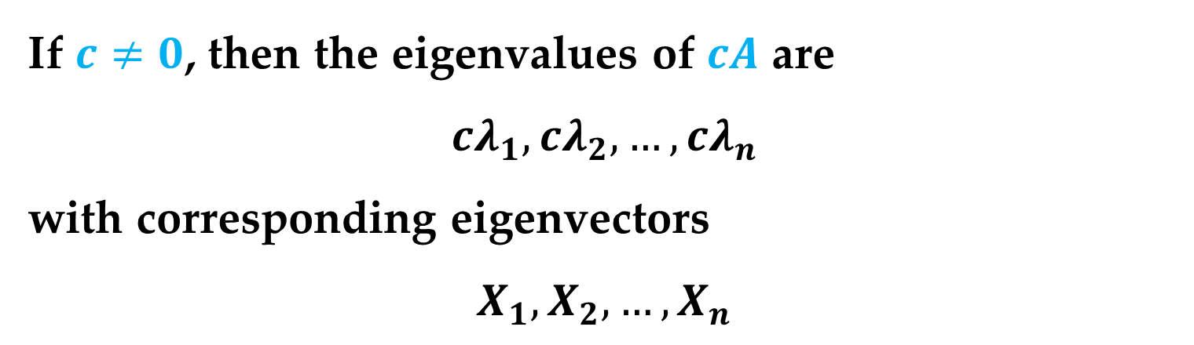
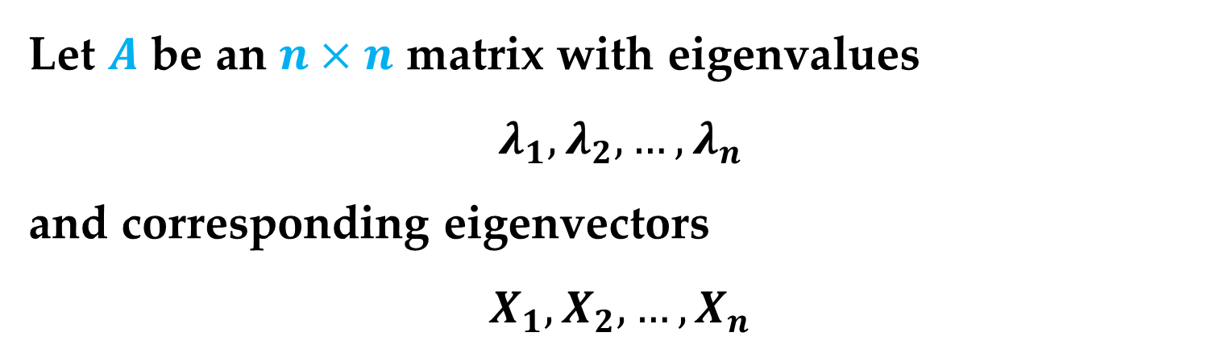
Theorem 1
Let $A$ be an $n×n$ matrix with eigenvalues
$$λ_{1},λ_{2},…,λ_{n}$$
and corresponding eigenvectors
$$X_{1},X_{2},…,X_{n}$$
If $c≠0$, then the eigenvalues of $cA$ are
$${cλ}_{1},{cλ}_{2},…,{cλ}_{n}$$
with corresponding eigenvectors
$$X_{1},X_{2},…,X_{n}$$
Introduction to Eigenvalues

Slide 20
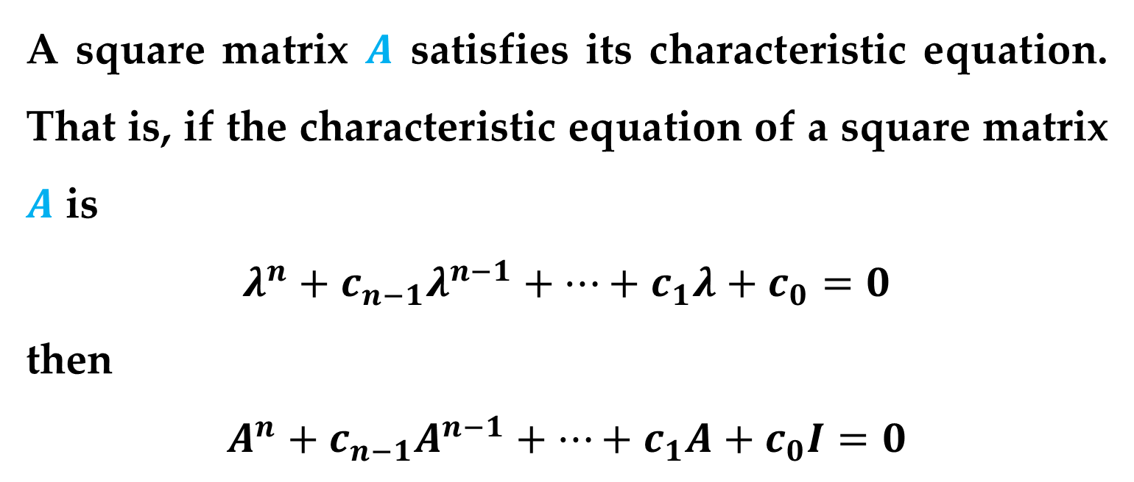
Theorem 2 (Cayley-Hamilton)
A square matrix $A$ satisfies its characteristic equation. That is, if the characteristic equation of a square matrix $A$ is
$$λ^{n}+c_{n−1}λ^{n−1}+…+c_{1}λ+c_{0}=0$$
then
$$A^{n}+c_{n−1}A^{n−1}+…+c_{1}A+c_{0}I=0$$
Introduction to Eigenvalues

Slide 21
Thank You for Attention

